Slide 1
Vomiting in pets
Proff: KAMAL M. ALSAAD
University of Basrah
College of Veterinary Medicine

Slide 2
Emesis is a common presenting sign in small animal practice.
It requires a rational approach to management that is based upon a sound understanding of pathophysiology combined with logical decision making.
Emesis is facilitated by a sequence of programmed overlapping and coordinated events which reduce the risks of adverse consequences (such as aspiration of acid stomach contents) whilst achieving elimination.

Slide 3
The reflex is controlled within the brainstem by a central pattern generator, loosely termed the ‘vomiting centre’
The reflex has visible phases of hypersalivation, retching and expulsion.
Efferent pathways controlling these processes include the vagal and phrenic nerves, parasympathetic nerves to the salivary glands and somatic motor nerves to abdominal muscles

Slide 4
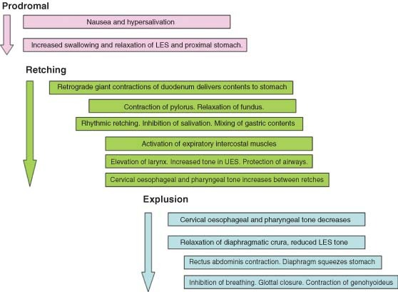
LES: Lower oesophageal sphincter.
UES: Upper oesophageal sphincter

Slide 5
Mechanism of emesis
Release of 5‐hydroxytryptamine/serotonin (5‐HT) from enterochromaffin cells, which have been demonstrated in canine and feline gastric and duodenal mucosa, stimulates vagal afferents via 5‐HT₃ receptors
Numerous chemicals, that can induce emesis when administered systemically, also do so via direct application to the area postrema. These include apomorphine, xylazine, prostaglandins and various hormones and peptides.

Slide 6
General causes of vomiting
Gastritis….
Lymphoplasmacytic
Granulomatous
Acute
Gastric neoplasia
Gastric ulceration
Ruptured diaphragm
Gastric dilatation/volvulus
Pyloric stenosis
Foreign body
Dietary

Slide 7
Infectious disease
Canine parvovirus
Canine distemper virus
Canine coronavirus
Salmonellosis
Campylobacteriosis
Fungal infection
Hookworms/Roundworms
Inflammatory bowel diseases
Intestinal neoplasia, Intussusception,Intestinal volvulus

Slide 8
Other causes …. Such as
Disease of nervous system
Peritonitis
Hepatobiliary disease
Splenic diseases
Pancreatic diseases
Renal diseases
Urogenital diseases such as Pyometritis, Endometritis and Urethrolithiasis
Uraemia
Ketoacidosis
Hepatic encephalopathy
Septicaemia and Toxicity

Slide 9
Consequences and complications of emesis…include
Emesis is associated with signs of
Nausea
Depression
Salivation
Lip licking
Increased swallowing motions
Loss of appetite
Those signs will leads to
Dehydration , hypovolaemic shock, acid‐base and electrolyte disturbances , aspiration pneumonia which can be life‐threatening

Slide 10
How to evaluated emetic animal….
Cardiovascular and hydration status, including mucous membrane color,
capillary refill time,
Heart and pulse rate, rhythm and strength
Evaluation of Body temperature
Presence of halitosisراحة الفم الكريهه & examination of oral cavity
Halitosis can be an indicator for the presence of necrosis in the oral cavity, pharynx or oesophagus, e.g. due to a foreign body or necrosis of the salivary gland
Evaluation of Body condition &Weight loss

Slide 11
Presence and localization of abdominal pain, and masses
Presence of free abdominal fluid
Presence and nature of any vaginal discharge
Color or vomitus …
Green vomit .. Ingestion of a large quantity of grass
Yellow vomit…it will consist mainly of bile due mainly of empty stomach
Black vomit…This is rare. Typically, black vomit could be a sign of mud or dirt that the pet digested accidently while they were playing. If black vomit has a similar appearance to coffee granules, if you find that it’s actually a very, very dark red, this may be a sign of a stomach ulcer or an undigested toxin.

Slide 12
White vomit…might due to Guttural inflammation of gastric mucus membrane or bloat with appearance of a foam
Red vomit…Red vomit is usually a sign that the pet is vomiting blood. If the blood is fresh (a normal shade of red), this could mean trouble with the lining of their stomach or possible inflammation; alternatively, vomiting blood could be a response to a poisonous substance.
Dark brown vomit…*Groans* especially if it smells strongly, is a sign that the pet has ingested too much poo. It can also be a sign that there’s a blockage in their intestines.

Slide 13
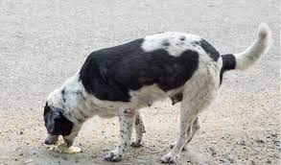
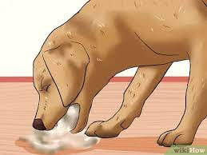

Slide 14
Diagnostic tests used in the investigation of dogs with emesis
Liver biopsy, evaluation of liver enzyme activity and/or bile acid concentration, total protein, abnormal appearance of liver on ultrasound
Endoscopy
Fecal examination
Urinalysis
Complete blood count, Lipid profile, Electrolytes
Evaluation of blood glucoses & calcium
Evaluation of Pancreatic enzymes
Ultrasounds and x ray

Slide 15
Treatment ….
1- prevent the primary cause
2-Antiemetics … such as
Acepromazine: 0.01‐0‐05 mg/kg i.m., or s.c. 1‐3 mg/kg
Chlorpromazine: 0.5 mg/kg i.m., s.c.for 6‐8h
Metoclopramide( plasil ) 0.2‐0.5 mg/kg i.m., s.c., p.o. for 6‐8h
Maropitant: standard emesis 1mg/kg s.c. every 24h. For prevention of motion sickness up to 8mg/kg p.o. for 24h for maximum of 2 days
Diphenhydramine 4 mg / animal orally

Slide 16
3-Systemic antibiotics ,,,such as
Gentamicin
Enroflaxcisin
4-diatary management
5-Fluid and electrolytes therapy

